Slide 1
MPIUA’s New Primary Insurance Rule
M
ALL QUESTIONS WILL BE ANSWERED AT END
Hosted by Michele Gillen and Paul Driscoll

Slide 2
What is this new rule from MPIUA?
Previously, MPIUA policies were capped at $1,000,000 for Coverage A. Now, with the new Primary Insurance Coverage Endorsement, MPIUA will serve as the primary insurer, allowing insureds to purchase separate excess coverage to go beyond the $1,000,000 limit—providing greater flexibility and protection.

Slide 3
What risks, policies are affected? When does it begin?
For Homeowners Policies (HO2 & HO3)
For Dwelling Fire Policies (DP2 & DP3 only)
For risks with Cov A at 1MIL and Replacement Cost greater than 1MIL
For New Business Only
Existing Policies s/b Rewritten
Effective April 15, 2025

Slide 4
What are the Benefits to Insureds?
Expands coverage beyond $1,000,000 by allowing excess policies. Remember, excess insurance covers the gap, provides full value for home and could rebuild fully!
Ensures MPIUA remains the primary insurer, simplifying claims handling.
Mandatory for properties where 90% of replacement value exceeds $1,000,000 (unless a Homeowners with the Special Loss Settlement Endorsement (HO 04 56)). Up until now, all properties required coverage at 80% of Replacement Cost to avoid co-insurance penalty. We all agree, more coverage is better.

Slide 5
How do agents address rule in SinglePoint? SinglePoint will be updated for Homeowners rating first, then Dwelling fire shortly thereafter. SinglePoint will add a Ma Fair Plan Carrier Option to select if Excess coverage is in place. Be sure to select in MPIUA site too!

Slide 6
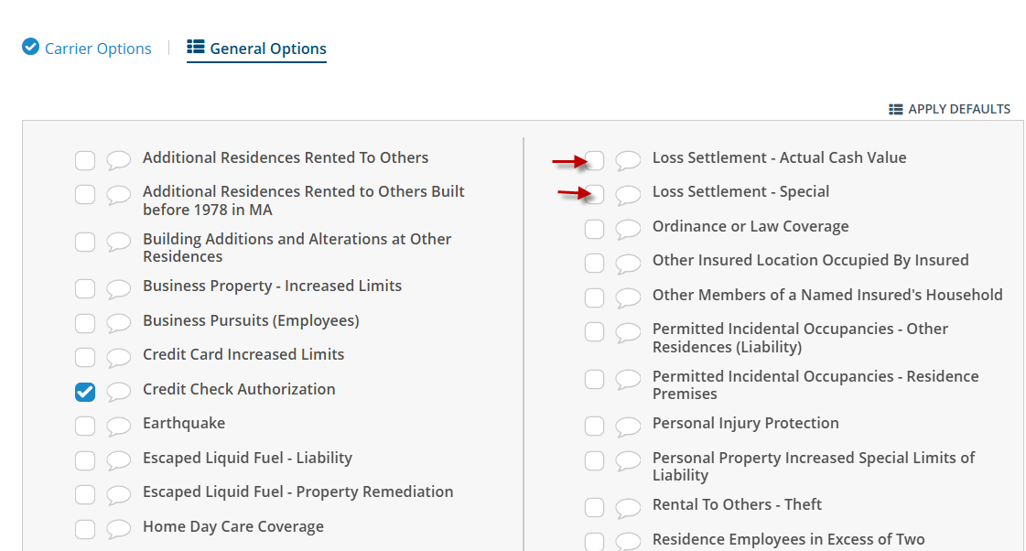
In General Options, under “L” select Loss Settlement Special HO 0456 or Loss Settlement ACV HO 0481

Slide 7
When choosing either type of Loss Settlement in SinglePoint, both have drop down options. -For “Special” select percentage of RC (50%, 60% or 70%) -For “ACV” select 80 if RC is between 50%-79% and select 50 when RC is less than 50%

Slide 8
Example #1 of New Rule Insuring a Home with Replacement value of 1.5MIL 90% of RC is 1.35MIL MPIUA still has maximum Coverage A of 1MIL Hence, MPIUA will only cover 66% of RC Mandatory steps below: Agent will do the following: 1- Obtain excess coverage of 350k from a surplus/excess market, OR 2- Add Special Loss Settlement HO 04 56 with no co-insurance penalty up to Cov A limit (see rule 302 in ISO manual) 3-Agent must notify MPIUA of excess coverage in the amount of 350k, or policy will be endorsed automatically with Special Loss Settlement HO 04 56 or ACV HO 04 81. Notification s/b within 30 days of effective date and a premium will be added.

Slide 9
Example #2 of New Rule
Insuring a Home with Replacement value of 2.3MIL
90% of RC is 2.07MIL
MPIUA still has maximum Cov A of 1MIL
Hence, MPIUA will only cover for 43.5% of RC
Agent will do the following: 1- Obtain excess coverage of 1.3MIL from a surplus/excess market
2-Agent must notify MPIUA of excess coverage in the amount of 1.3MIL, or policy will be endorsed automatically with ACV HO 04 81. Notification s/b within 30 days of effective date and a premium will be added.

Slide 10
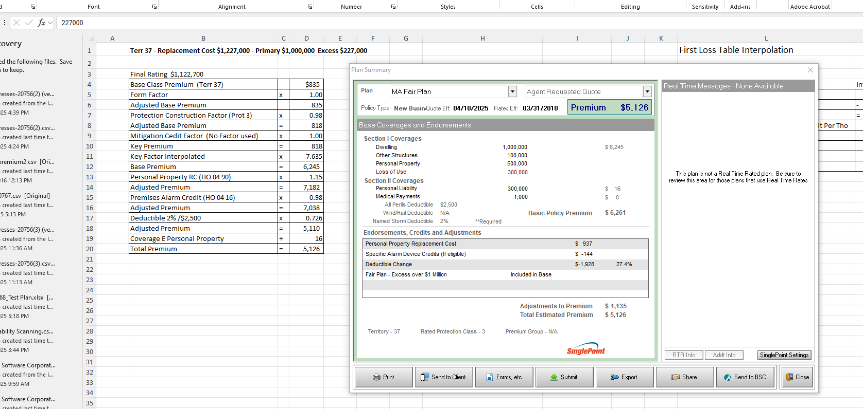
Fair Plan New Rule Match of Rates from MPIUA to SinglePoint

Slide 11
Who can agents contact with additional questions?
Call MPIUA Customer Service 617-723-3800
Send proof of excess coverage to: excesspolicy@mpiua.com
If there is a technical or rating issue in SinglePoint, contact Boston Software at
781-449-8585, Press “1” for Tech Support or use our Live Chat
or email us at support@bostonsoftware.com

